Slide 1


Mobile Wallet with Expense Tracker and Budget Planner
Presented by:
Kavin. A(192321003)
ITA0302 MOBILE COMPUTING

Slide 2
Introduction
Overview of the project:This project involves developing a mobile application that functions as a digital wallet, integrated with an expense tracker and budget planner. The app will enable users to make payments, automatically categorize expenses, track financial activity, and set/manage budgets. It provides a unified platform for personal finance management, combining security, usability, and intelligent financial insights.
This project involves developing a mobile application that functions as a digital wallet, integrated with an expense tracker and budget planner. The app will enable users to make pay
Problem statement:Managing personal finances manually or through scattered apps often leads to poor tracking, overspending, and lack of savings discipline. Users need an all-in-one solution to streamline payments and financial planning effectively.
Purpose of the project:To build a secure and user-friendly mobile wallet app that helps users track their expenses, plan budgets, and analyze spending patterns. The aim is to improve financial literacy, foster better saving habits, and ensure seamless financial management through automation and smart insights.

Slide 3
Objectives
Develop a secure and intuitive mobile wallet for digital payments
Integrate real-time expense tracking with automatic categorization
Enable users to create and manage monthly or custom budgets
Provide detailed reports and visual analytics for financial insights
Ensure data privacy and synchronization through cloud storage
Enhance user financial discipline and awareness through alerts and tips
Design the app to be scalable and easily extensible for future features (e.g., investment tracker, credit score monitoring)

Slide 4
Literature Review / Background
The growing reliance on smartphones has led to a surge in mobile financial applications. Digital wallets like Google Pay, Paytm, and Apple Pay have transformed the way people perform financial transactions by offering convenience, speed, and security. However, these applications typically focus solely on payments and often lack comprehensive personal finance management tools such as expense tracking and budget planning.
On the other hand, standalone expense tracking apps like Mint, Goodbudget, and YNAB (You Need A Budget) provide strong budgeting features but do not offer integrated payment systems. This creates a fragmented user experience, forcing users to rely on multiple apps to manage their finances.
Recent studies highlight that integrated solutions can improve user engagement and financial literacy. According to a report by Deloitte, consumers are increasingly looking for "all-in-one" financial platforms that provide both transactional and analytical capabilities.
By combining a digital wallet, expense tracker, and budget planner into one unified app, this project aims to fill the gap in the market. It leverages existing technologies in mobile development, cloud computing, and data visualization to provide users with an efficient and secure tool for managing their money.

Slide 5
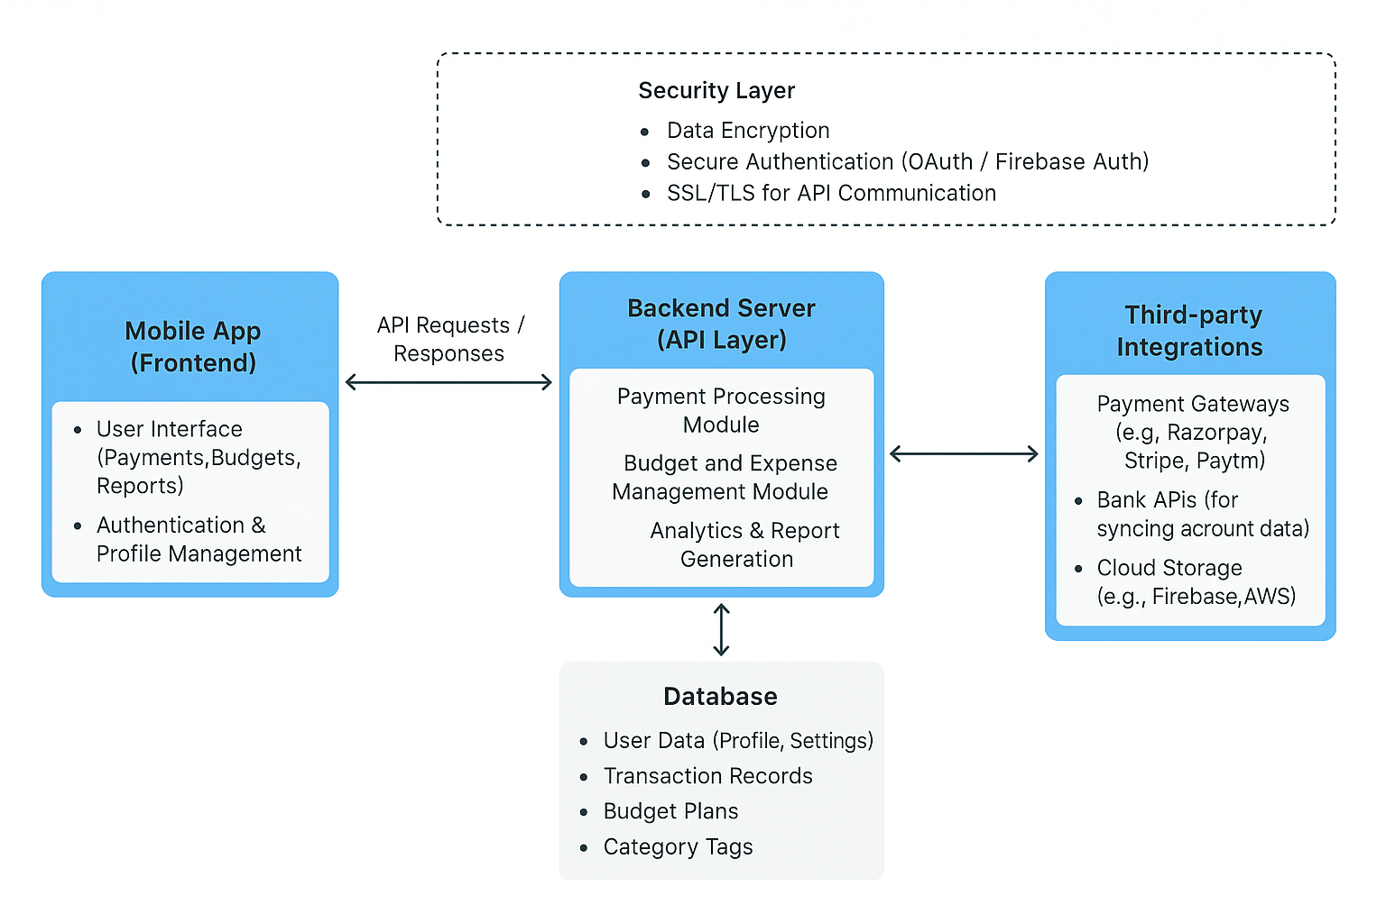
System Design / Architecture

Slide 6
BENEFITS
Centralized Financial Management
Users can make payments, track expenses, and manage budgets all in one app, reducing the need for multiple tools.
Improved Financial Awareness
Real-time tracking and visual analytics help users understand their spending habits and make informed decisions.
Enhanced Budgeting Discipline
Automated budget tracking, alerts, and tips encourage users to stay within budget and save more effectively.
Secure and Convenient Transactions

Slide 7
CONCLUSION
The proposed mobile application offers a comprehensive solution for managing personal finances by integrating digital payments, expense tracking, and budget planning into a single platform. It addresses the limitations of fragmented financial tools by providing users with a seamless, secure, and intelligent system that promotes better financial habits. Through features like real-time tracking, automated categorization, and insightful analytics, the app empowers users to take control of their finances with ease and confidence. The scalable and user-centric design ensures adaptability to future enhancements, making it a valuable tool in the digital financial ecosystem.

